Slide 1
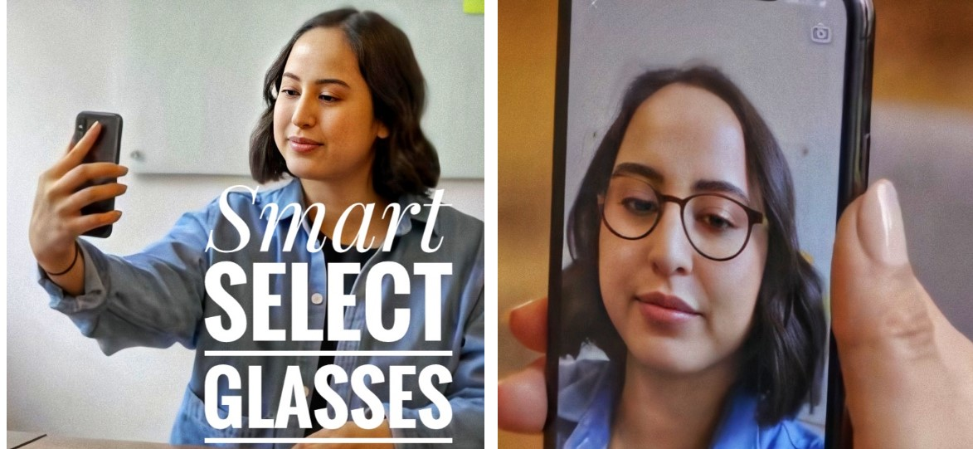
Smart Select Glasses (SSG)
Name : Mohamed Magdy Mohamed Tawfik Diab
Supervisor : DR . Sara Nabil

Slide 2
THE IDEA
What’s SSG ?
Who benefit from it?

Slide 3
Introduction
Good Morning Everyone!
My Topic Today is “Smart Select Glasses ( SSG )” and I’m going to talk for about five minutes on this subject

Slide 4

PROBLEM
Many people don't have time to go to the glasses store; to buy glasses that fit their face, so some go to buy glasses from many sites such as Amazon or Souq and when the customer receives the order, they find that the glasses don't match the customer's face at all. The customer must recover the product and this costs the customer time and money as well as the service provider, so you decided to create a program to resolve this issue.

Slide 5

Solution
I will create an application linked to a database that the service provider will display the merchandises thereon and also information about the merchandise and also the place of the sale so customer creates an account on the App and complete some information like gender: male or female so AI creates 3 frame choices per person, supported the customer’s face shape, gender, age, and also the foremost well-liked frames purchased by similar customers within the previous month.

Slide 6
stakeholders
Administrators
Service providers
Customers

Slide 7
Project scope
The proposed system will deal with the people involved. It is particularly introduced as an integrated platform for To buy and sell glasses.
The system interface will deal with the following:
1. Administrators: adding, updating information.
2. service provider: It displays its products and adds information about the product and the place of sale.
3. customer: Log in to the app to purchase the right and product and order online.

Slide 9
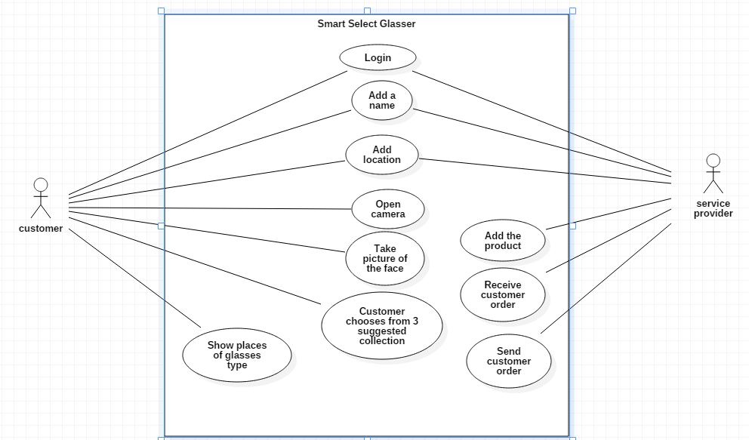

Slide 10
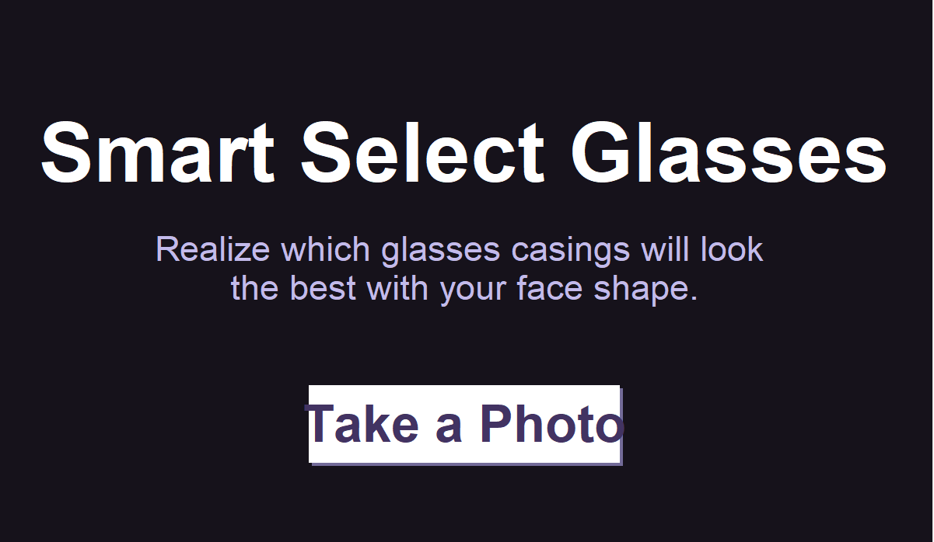

Slide 11
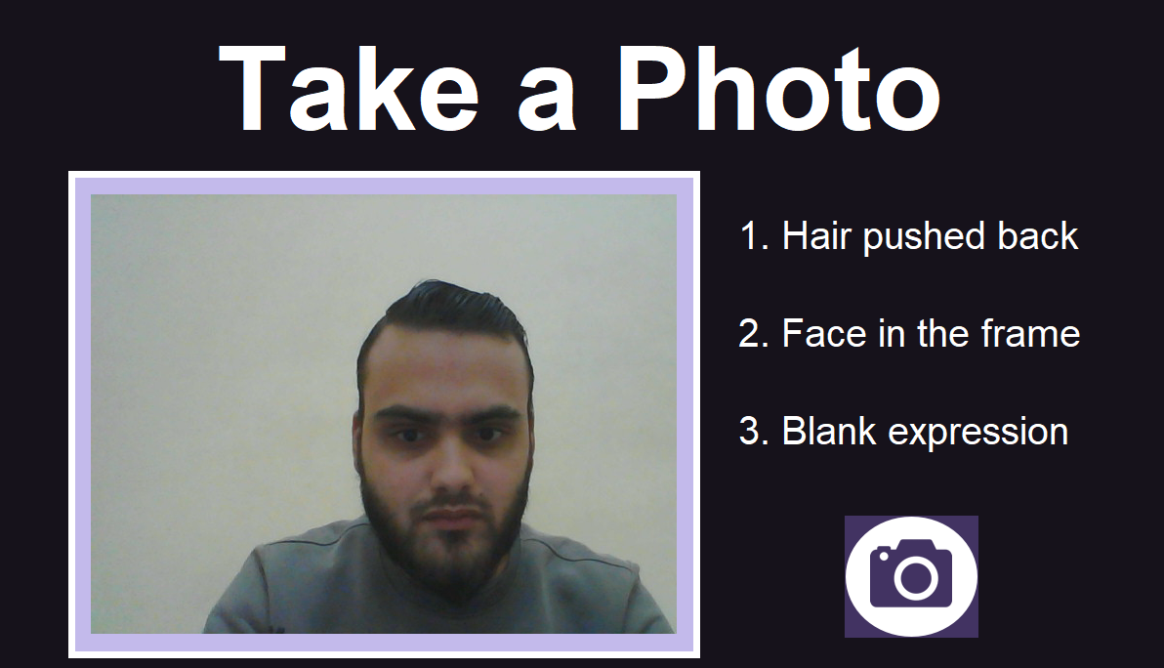

Slide 12
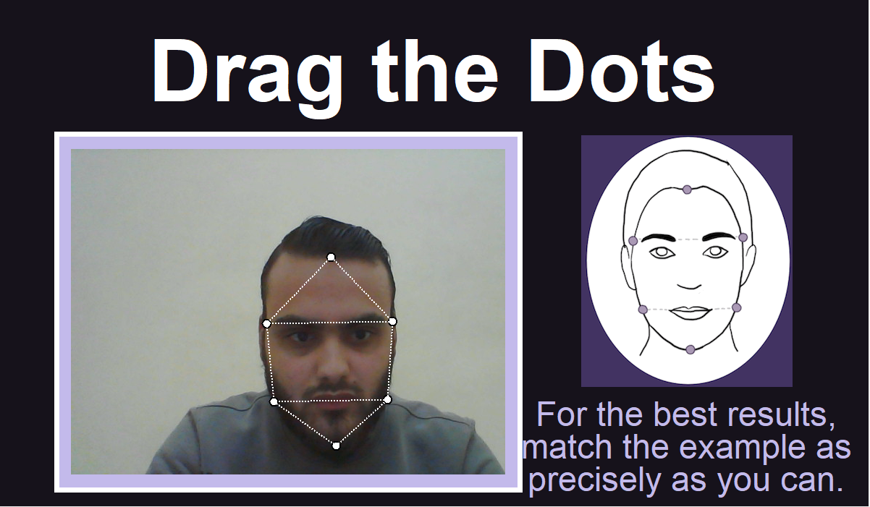

Slide 13

Thank You ……

